Slide 1
Master Plan
November 2019

Slide 2
Master Plan Outline
Incorporates court, infrastructure and environmental setting upgrade to Upper and Lower Complex
Facilitates court upgrades to accommodate projected growth areas
Integrates planned squash complex facilities with tournament quality courts on Lower Complex
Elevates existing Upper Complex infrastructure to a modern, functional and community friendly Centre
Improves front desk management and retail pro-shop
Phased approach to allow funding to be attained for each stage with minimal disruption to current operations
Overall objective to attain Tennis NSW Tier 2 Ranking while maintaining community based operations and financial viability.

Slide 3
Master Plan - Goals and Schedule
Tier 2 Ranking
Phase 1
Phase 2
Phase 3
Upper Complex Infrastructure Upgrade
Ongoing maintenance
Visual site improvement
Hotshot courts
Expanding the product
Lighting Improvement
Court re-configuration
Entry statement and impact
Securing finance
Lower Complex Court Upgrade
Ongoing maintenance
High Level Tournament standard facilities
Achieving operational excellence
Achieving financial independance
Planning and costing
Urgent maintenance and upgrade
Visual site improvement
Coaching Excellence
Financial performance improvement
Product definition
2019
2021
2023
2025
Now
Short Term
Medium Term
Long Term

Slide 4
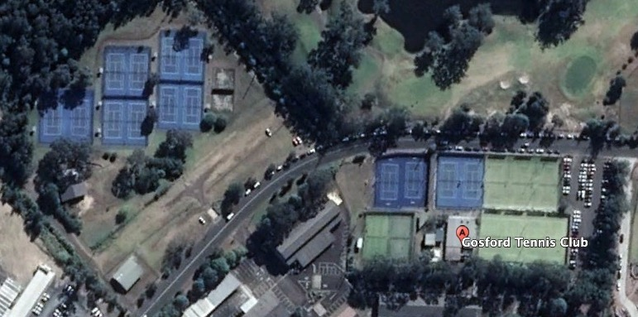
Master Plan Existing Infrastructure
Lower Complex
Upper Complex

Slide 5
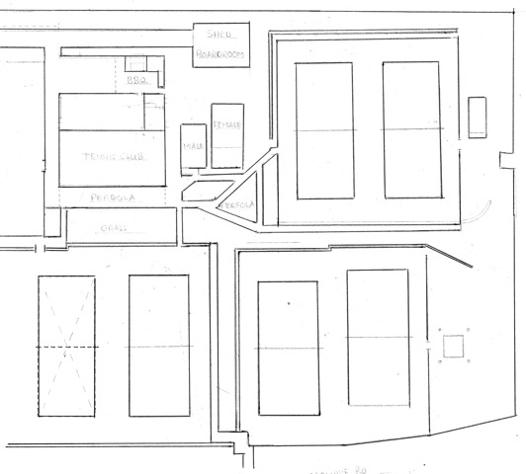





Phase 2: Upper Complex Infrastructure
Existing Configuration
S
shed
Legend
6
4
2
1
Blue Room
1
3
2
BBQue area
club house
5
3
Kitchen
Scale
4
Board Room
11 metres
5
Toilet Block
`
6
Coaches Storage Area
Pergola
Driveway
Pathway
Grassed Area
Racecourse Road

Slide 6
Phase 2: Upper Complex Infrastructure
“ Identifying the issues”
Current Issues
Outdated Toilet Block located inappropriately
Inadequate coaches storage area
Board room and shed white ant infested and unsafe
Inadequate viewing areas
Inadequate shaded areas
Review internal club house functionality
Review blue room functionality
Review kitchen operations
Upgrade of back access road required
Landscaping and drainage plan
Modular upgrade approach to restrict impact on operations

Slide 7

Phase 2: Upper Complex Infrastructure
High Level Conceptual Plan
Item No. | Description
1 | Garage, equipment storage, maintenance centre, internal tba
2 | Toilet block incorporating change room, shower facility, lockers
3 | Gym, coaches storage, first aid, physio, internal tba.
4 | Blue room – trophy cabinant, club history, honor rolls, meeting room, internal layout tba
5 | Existing kitchen – shutter and bench facing 6.
6 | Closed serving area incorporating BBQ, coffee machine, fridge, Pull down lockable shutters on three sides
7 | Clubhouse – internal configuration tba
8 | Open area – serving and seating area pergola covered
9 | Alfresco open area – wooden hardwood deck flooring sail covered, seating and tables, landscaping
10 | Covered walkway
Required Short Term Outcome: decide on concept
High Level Cost estimate $350,000 – to be subsidised

Slide 8
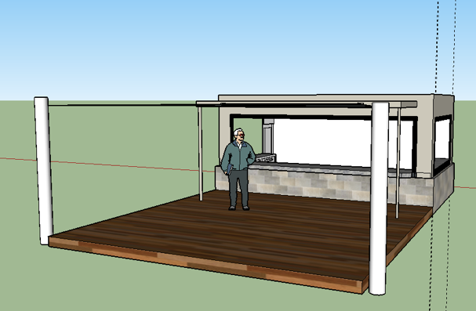

Phase 2: Upper Complex Infrastructure
Conceptual Side View Alfresco Area
Roll down Shutters
BBQ – Coffee – Food Sales
Not to scale

Slide 9
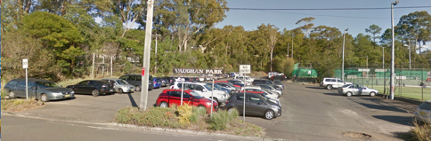

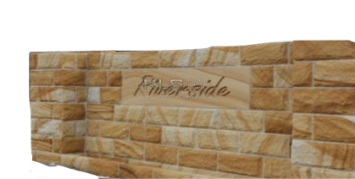

Phase 2 : Upper Complex
Entry Option Concept- “Enhancing the Image”
existing
Option
Gosford District
Tennis Club

Slide 10
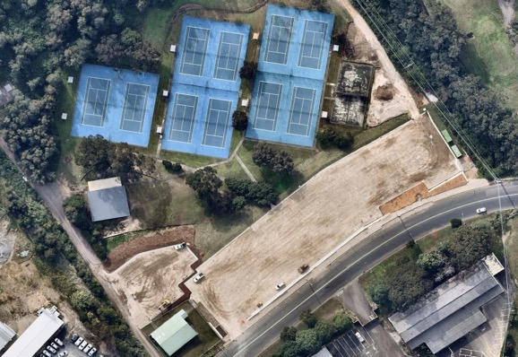
Phase 3 Lower Complex Integration with CCSSC
“ Catalyst for Lower Complex Upgrade”
EXISTING TENNIS COURTS TO REMAIN. NEW SPORTS CENTRE TO FACILITATE OFFICE, KIOSK AND MULTI ROOM FOR TENNIS OPPERATIONS
PROPOSED NEW CENTRAL COAST SQUASH CENTER
Existing Lower Complex
Proposed Lower Complex

Slide 11
Phase 3 Lower Complex Proposed CCSSC Level Plans
Lower Ground Level Plan
Main Level Plan

Slide 12
Phase 3 Lower Complex Proposed CCSSC Development Side View
Elevation South

Slide 13
Phase 3 – Tournament Grade Lower Complex
Current Concept
Lift courts by 1 metre
Introduce internal drainage and resurface
Estimated high level cost $1.2 million

Slide 14
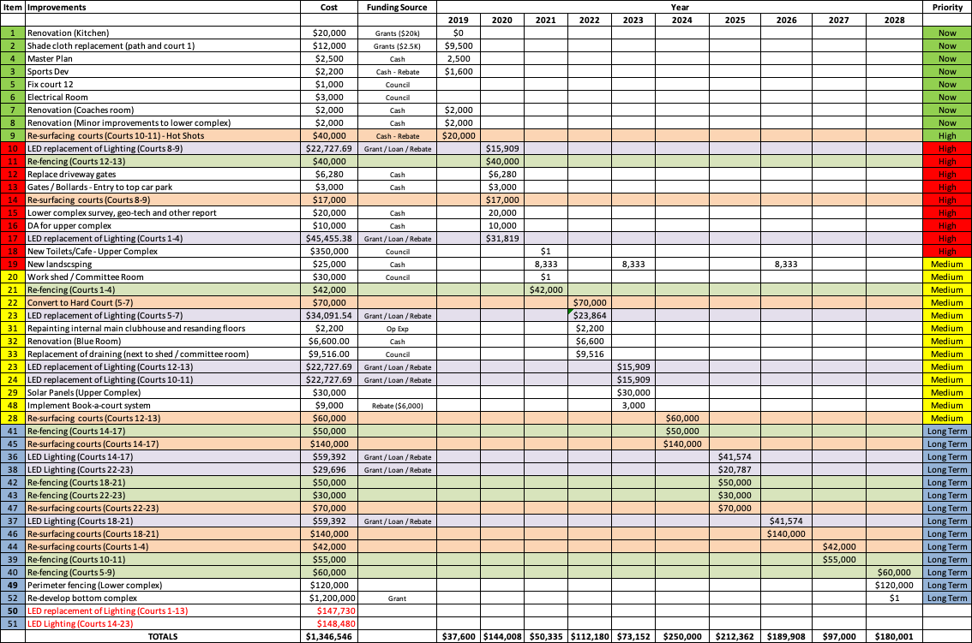
Master Plan – Schedule and Budget

